Slide 1
Data Visualization using Excel
Company Sales Data from 2014 Qtr3 to 2015 Qtr2
Etana Disasa
College of Computer & Information Sciences
Regis University

Slide 2
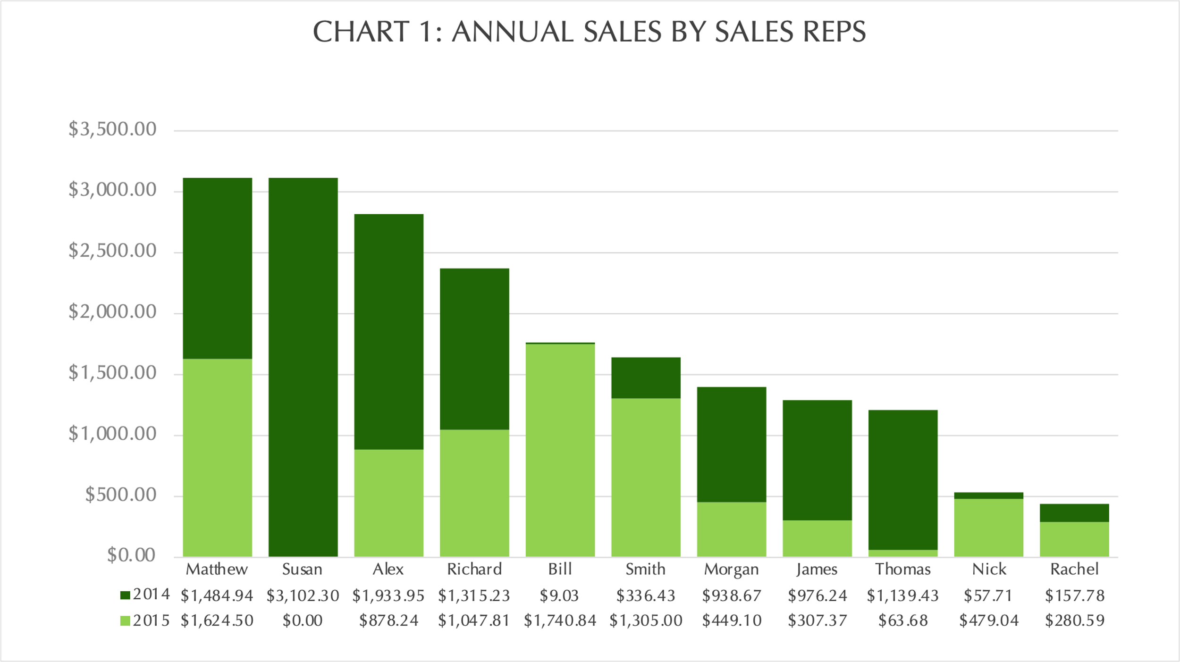
Annual Sales
The data utilized is ‘Easy Sales Data.xls’.
This first stacked column chart with data table at the bottom that displays the annual sales by each sales representative.
Matthew’s combined sales stands leading the rest of the team. However, Susan’s performance in just year 2014 alone is shy of a few dollars to over take Matthew’s sales.
Bill is also a Rep who’s performance profoundly grew from 2014 to 2015.
Rachel’s performance relatively came back low followed by Nick.
Overall, sales have declined from 2014 to 2015.

Slide 3
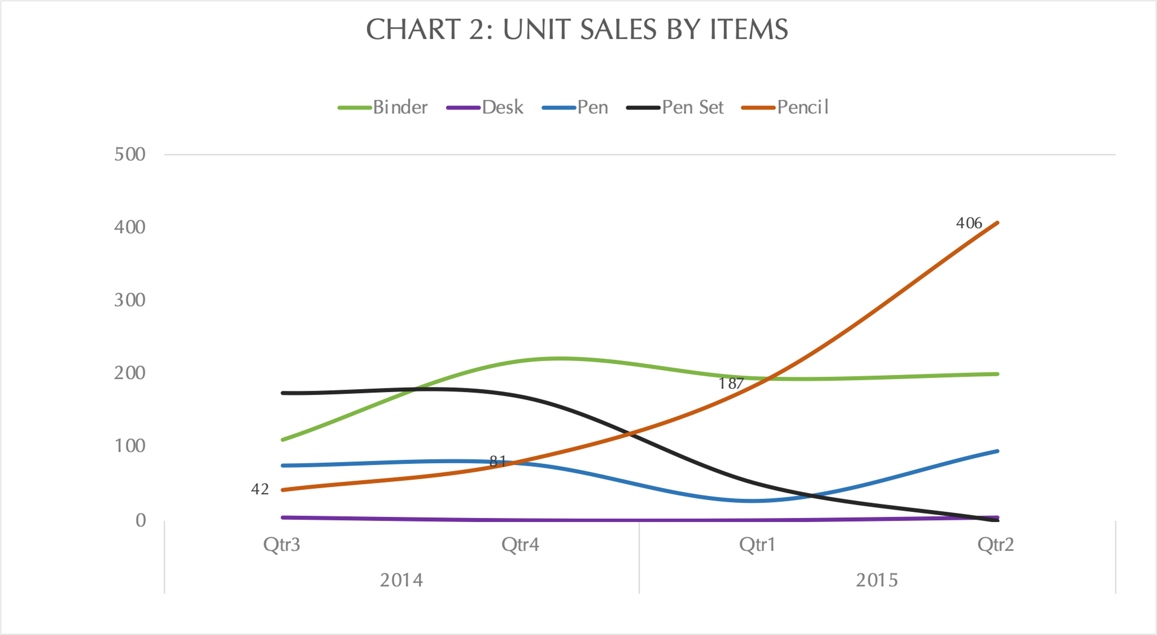
Item Unit Sales per Quarter
This line charts shows the unit sales of item per quarter between 2014 Qtr 3 through 2015 Qtr 2.
The total unit sale for Pencil continued to grow as other items fluctuated.
From a total of 42units, by the end of 2015 Qtr2, salves grew to 406units.
Pen Set unit sales, however, has been declining during this time period.

Slide 4
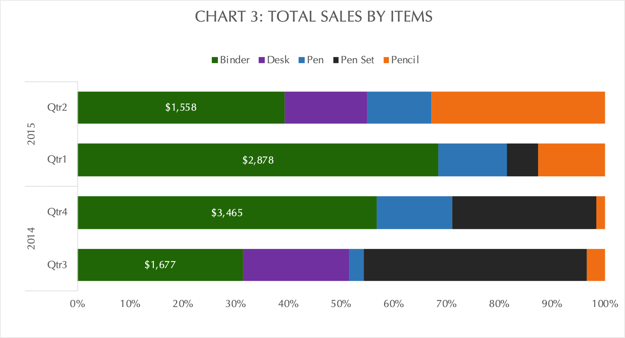
Total Sales per Quarter
This 100% stack bar displays total sales by item for the 2014 Qtr3 through 2015 Qtr2.
Even though, the quantity of sold Pencil units increased, it appears that Binder sale brought significantly more revenue during this period.
Pen Set sales were the largest sales generators of approximately 40% of the total sale during the 2014 Qtr3 period.
However, the sales gradually slowed until in 2015 Qtr2, no sales was registered.
Pen sales also generated encouraging growth.
Nevertheless, all other items have been showing a relatively promising gain except for Desk. No revenue was generated for 2014 Qtr4 and 2015 Qtr1.

Slide 5
Conclusion
The company’s overall sales revenue declined from 2014 to 2015. Even though, Bill’s performance grew tremendously, most reps performed poorly in 2014 compared the year before.
There was a significant uptick in Pencil unit sales from 2014 Qtr3 through 2015 Qtr 2. However, Binder sales appear to be bring more revenue after all.
Pen sales was also another promising item that showed continuing growth during this time period. However, Pen Set sale declined drastically.

